Slide 1
Vehicle Fuel Economy Data
By
Justice Nii-Ayitey
University of Idaho
11/29/2018

Slide 2
Introduction
We have different brands of vehicles such as Dodge, Subaru, Toyota, Volkswagen, Volvo, Audi, BMW and others
Each brand has different models
Toyota for instance, has different models such as Camry, RAV4, C-HR, Prius , Yaris, Land Cruiser, Tacoma, 4Runner, etc.
Also, each vehicle has a fuel that it uses

Slide 3
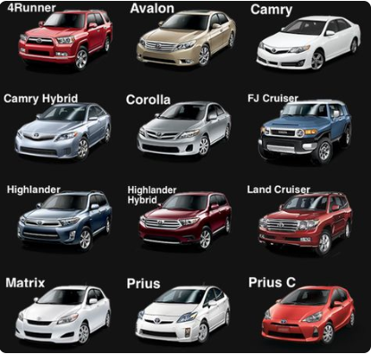
Introduction
Do people buy cars based on the brand or the model?
Have you also though about the fuel consumption of your car and the cost?

Slide 4
Objectives
Classifying vehicles that operate on a blend of gasoline and electricity in charge depleting mode
Predicting annual fuel cost
Predicting annual petroleum consumption in barrels

Slide 5
Data Description
Dataset was from KAPSARC Data Portal
39588 total observations with 83 variables
Some variables of interest are:
barrels08 - annual petroleum consumption in barrels for fuelType1
fuelCost08 - annual fuel cost for fuelType1
mpgData - has My MPG data
phevBlended - if true, this vehicle operates on a blend of gasoline and electricity in charge depleting mode
make - manufacturer (division)

Slide 6
Classification (phevBlended)
phevBlended was categorical (i.e. True or False) as response variable
Hence classification for the response variable
Some models to explore under the classification includes:
k-Nearest Neighbor
Naive Bayes
Logistic Regression
Decision Trees
Random Forest
Neural Networks
Support Vector Machine

Slide 7
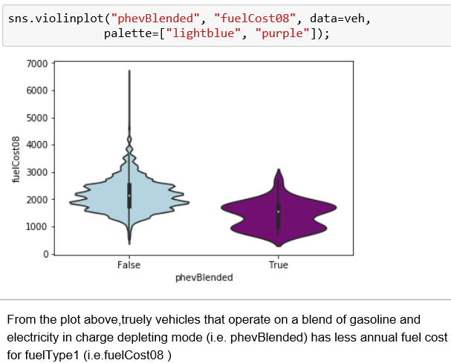
Descriptive Statistics

Slide 8
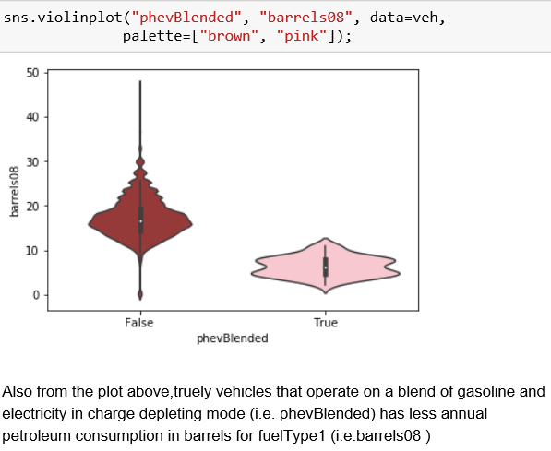
Descriptive Statistics (cont.)

Slide 9
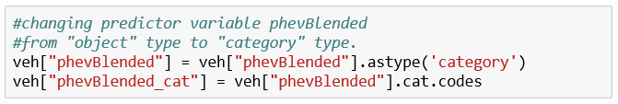
Preprocessing

Slide 10
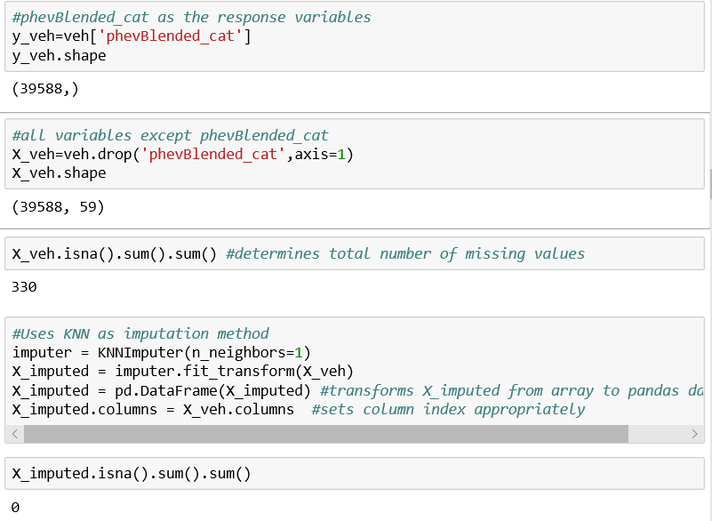
Preprocessing (cont.)

Slide 11
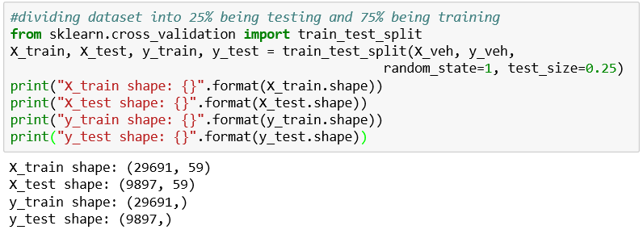
Train and Test Datasets

Slide 12
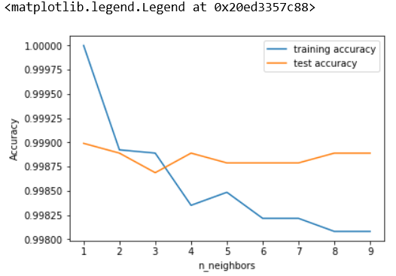
Analyzing KNeighborsClassifier

Slide 13
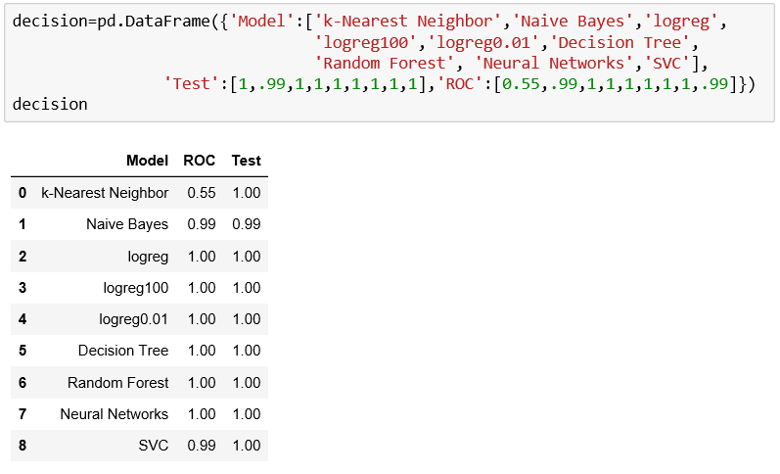
Classification Models (Suammary)

Slide 14
Regression (barrels08)
barrels08 as a response was continuous
Once the response is continuous, regression is considered
Some models to explore under the regression includes:
KNeighbors Regressor
Linear Regression aka Ordinary Least Squares
Ridge regression
Lasso
DecisionTree Regressor
RandomForest Regressor

Slide 15
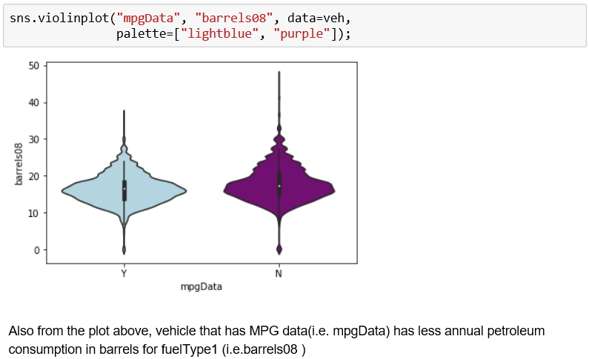
Descriptive Statistics

Slide 16
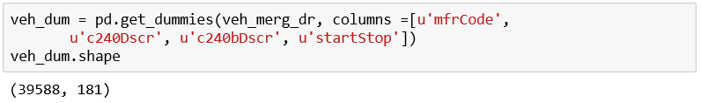
Preprocessing
Removing unwanted variables (39588, 20)
Converting “createdOn” and “modifiedOn” variables into vectors
Merging the variables

Slide 17
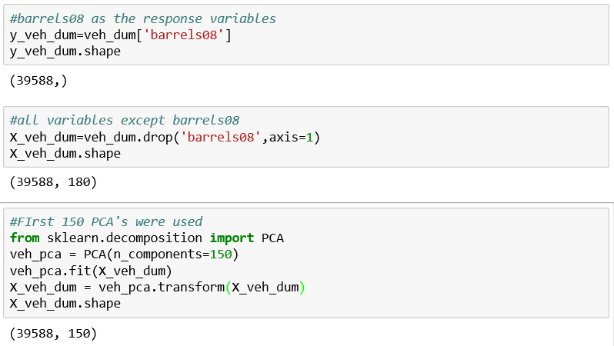
Preprocessing (cont.)

Slide 18
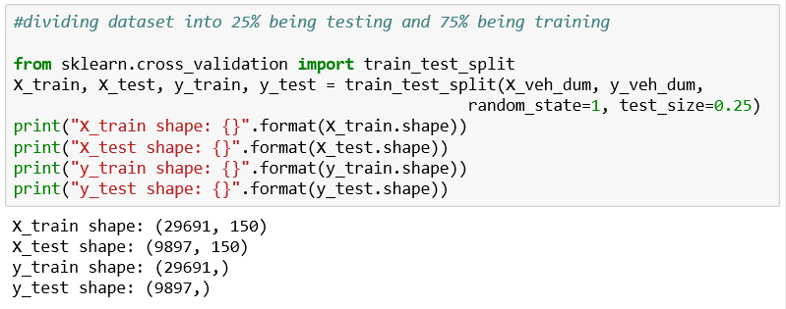
Train and Test Datasets

Slide 19
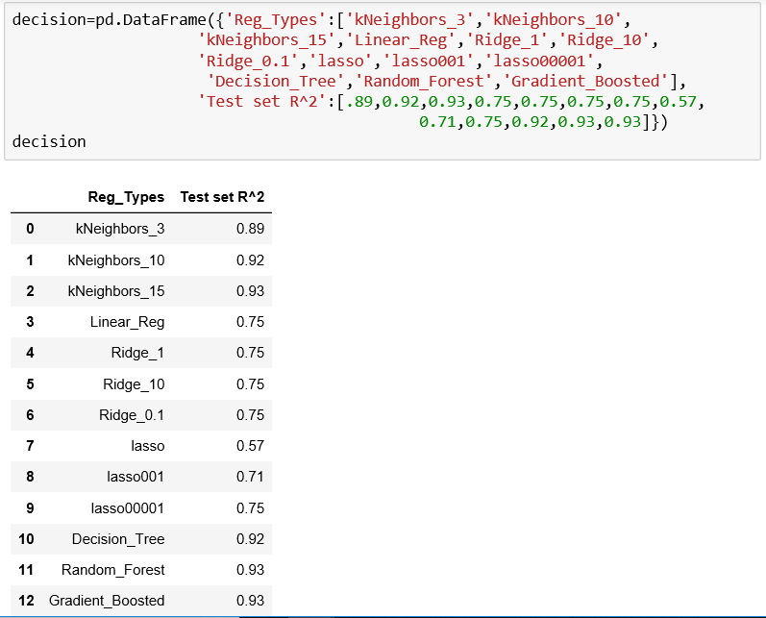
Regression Models (Summary)

Slide 20
Conclusion
From the regression analysis, lasso had the lowest R^2 of 0.57 while kNeighbors_15, Random_Forest, Gradient_Boosted both had the highest R^2 of 0.93
In conclusion, we can assume any of these as the best model for predicting barrels08 respectivley.

Slide 21
Future Study
In future study, we could explore some clustering, association and seriation analysis for the Vehicle Fuel Economy data under unsupervised learning

Slide 22
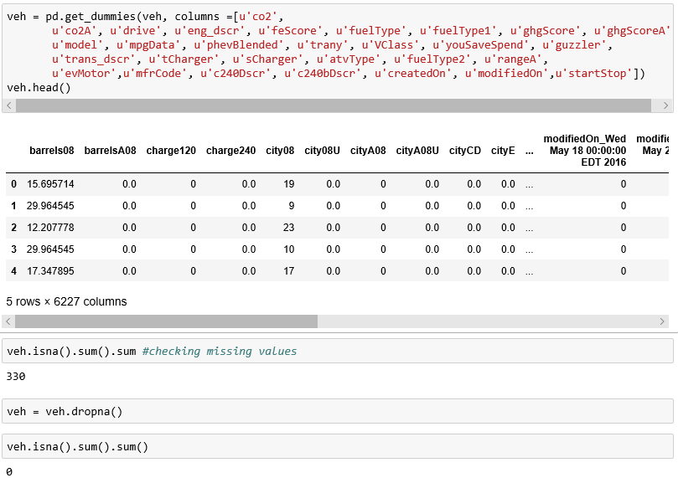
Preprocessing

Slide 23
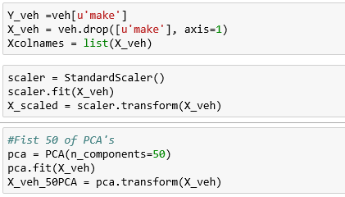
Partitioning

Slide 24
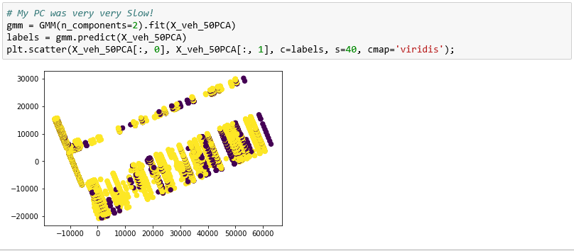
Visualization

Slide 25
Thank you.

